Slide 1
1. Update Patient Example
row 1000
mrn 103270
2f_name Amy
l_name Shaw
mi Vb
_sex F
gender femal
eb_date 39133
lang en|English
race_cat_1 2106-3|White
race_cat_2 1002-5|American Indian or Alaska Native
race_cat_3 2028-9|Asian
race_det_1 1586-7|Shoshone
race_det_2 2036-2|Filipino
ethn_cat hispanic or latino
ethn_det_1 2184-0|Dominican
ethn_det_2 2148-5|Mexican

Slide 2
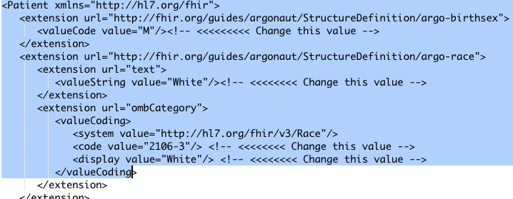
2. Update Xml ”Template”
https://github.com/Healthedata1/Manual_Examples/blob/master/Manual%20Argo%20patient%20templae.xml

Slide 3
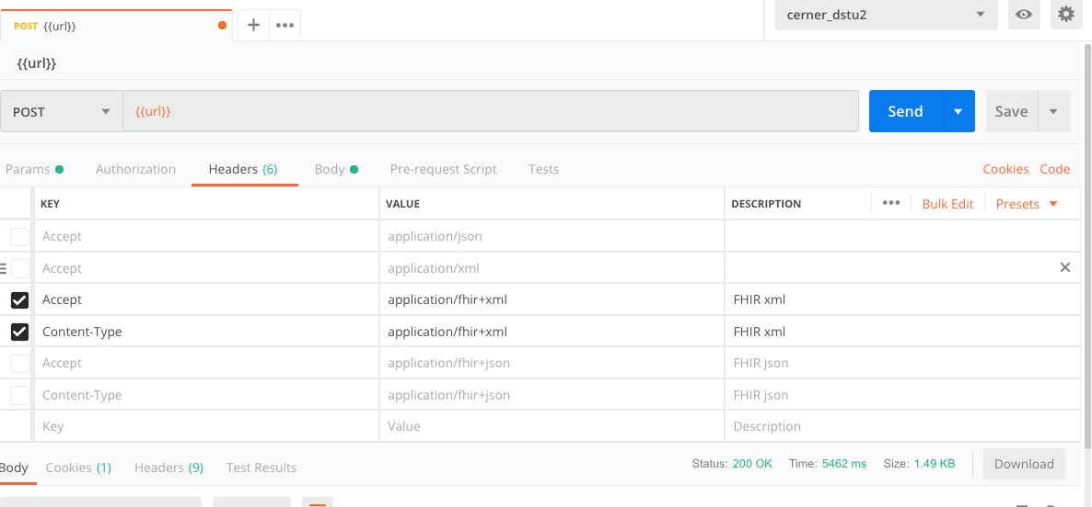
3. Select Endpoint and add Headers

Slide 4
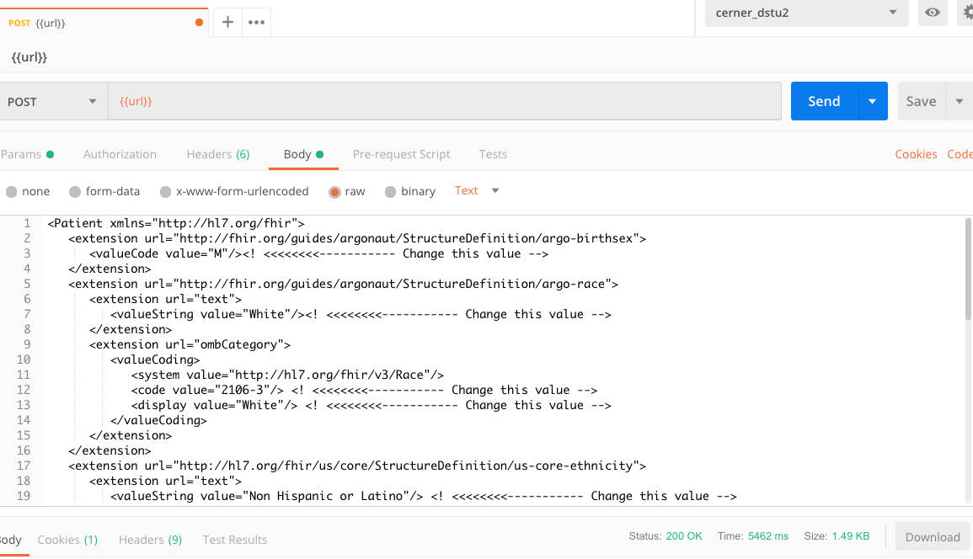
4. Copy and Paste body into Postman and Click Send

Slide 5
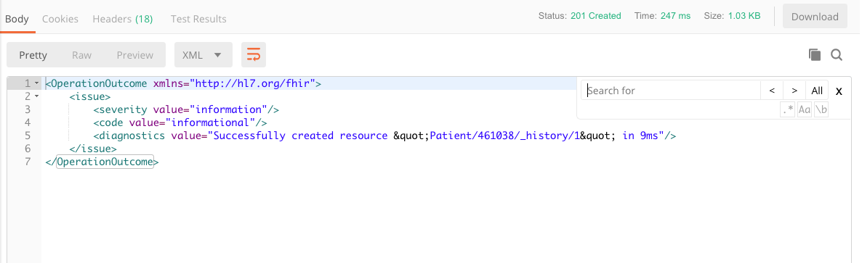
5. Look for status in Response

Slide 6
Provider Directory examples
Link:
https://github.com/Healthedata1/Manual_Examples/blob/master/argo-pd.csv
Base URL: http://sqlonfhir-stu3.azurewebsites.net/fhir

Slide 7
Provider Directory examples
Search for Practitioner by demographics
Name: GET [Base]/Practitioner?name=[name]
Specialty:
Get [Base]/PractitionerRole?specialty=[code]&_include=PractitionerRole.practitioner

Slide 8
Provider Directory examples
Search for Practitioner within a region (city, state)
Practitioner or specialty within a specified distance
- 10 miles from patient home → use near parameter
Show me every one of this specialty in the city
- Specialty Get [Base]/PractitionerRole?address-city=[code]

Slide 9
Provider Directory examples
Search for Organization and facility by:
Name: Get [Base]/Organization?name=[name]
Address: Get [Base]/Organization?address=[text]

